Slide 1
Taproot – Part II

Slide 2
Outline today
Schnorr Signatures
Recap
Linearity
Key aggregation
Benefits compared to ECDSA
Short excursion
MuSig
Key aggregation problems
Solutions
MuSig2
Taproot: tweaked public key

Slide 3
Schnorr Signatures
Comparison to ECDSA

Slide 4
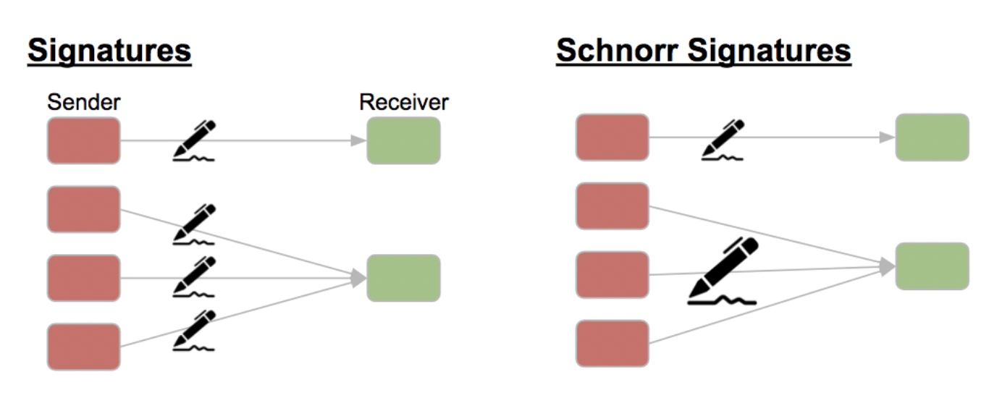
Schnorr Signatures (BIP 340)
It becomes impossible to say if the sender is one person or several

Slide 5
Schnorr Signatures – How it works
Generator G and point on curve is 𝑌 = 𝑥 ⋅ 𝐺 where 𝑥 private key and 𝑌 public key
Choose random & secret 𝑘, 0 < 𝑘 < 𝑛
𝑅 := 𝑘 ⋅ 𝐺
𝑒 := H(𝑅_{x} ∥ 𝑚) *→
𝑠 := (𝑘 + 𝑥 𝑒) mod 𝑛
Verify signature of 𝑚: (𝑅, 𝑠) provided
𝑠 ⋅ 𝐺 = 𝑅 + H(𝑅_{x} ∥ 𝑚) ⋅ 𝑌
Verify signature of 𝑚: (𝑒, 𝑠) provided
Calculate 𝑅 = (𝑠 ⋅ 𝐺) – (𝑒 ⋅ 𝑌)
Check 𝑒 = H(𝑅_{x} ∥ 𝑚)
𝑅_{x} = (𝑘 ⋅ 𝐺 )_{x} mod 𝑛 If the bit length of 𝑒 is greater than the bit length of 𝑞 is, before the calculation of 𝑠, the surplus (right) bits of 𝑒 are deleted.

Slide 6
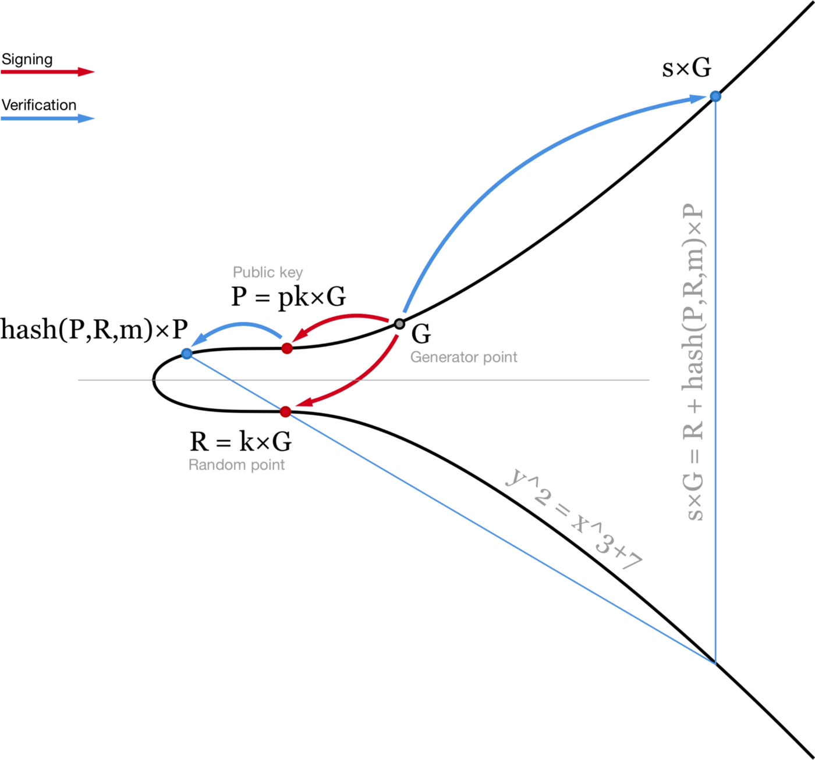
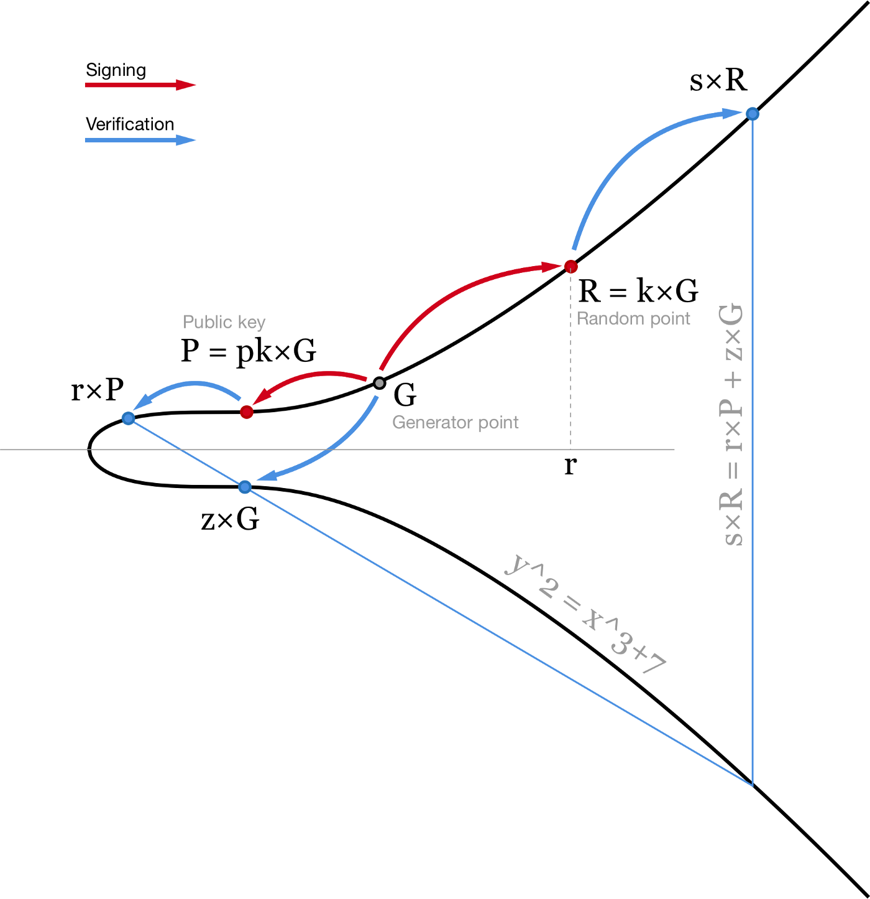
Schnorr Signatures – Visual ECDSA comparison
Schnorr
ECDSA:
https://medium.com/cryptoadvance/how-schnorr-signatures-may-improve-bitcoin-91655bcb4744

Slide 7
Schnorr Signatures – ECDSA comparison
Schnorr:
Choose random & secret 𝑘, 0 < 𝑘 < 𝑛
𝑅 := 𝑘 ⋅ 𝐺
𝑒 := H(𝑅_{x} ∥ 𝑚)
𝑠 := (𝑘 + 𝑥 𝑒) mod 𝑛
Verify signature of 𝑚: (𝑅, 𝑠) provided
𝑠 ⋅ 𝐺 = 𝑅 + H(𝑅_{x} ∥ 𝑚) ⋅ 𝑌
⇒ 𝑠 ⋅ 𝐺 = (𝑘 + 𝑥 𝑒) ⋅ 𝐺
ECDSA:
Choose random & secret 𝑘, 0 < 𝑘 < 𝑛
𝑅 := 𝑘 ⋅ 𝐺
𝑒 := H(𝑚) & 𝑧 := 𝐿_{𝑛} leftmost bits of 𝑒
𝑠 := 𝑘⁻¹ (𝑧 + 𝑅_{x} 𝑥) mod 𝑛
Verify signature of 𝑚: (𝑅, 𝑠) provided
𝑠 ⋅ 𝑅 = 𝑅_{x} ⋅ 𝑌 + 𝑧 ⋅ 𝐺
Calculate 𝑈 := ( 𝑧 𝑠⁻¹ mod 𝑛 ) ⋅ 𝐺
Calculate 𝑉 := (𝑅_{x} 𝑠⁻¹ mod 𝑛 ) ⋅ 𝑌
Check 𝑅_{x} = (𝑈 + 𝑉)_{x}
⇒ 𝑅_{x} = [ (𝑧 + 𝑅_{x} 𝑥) / (𝑧 + 𝑅_{x} 𝑥) 𝑘 ⋅ 𝐺]_{x}

Slide 8
Schnorr Signatures vs. ECDSA – Key aggregation
Schnorr:
Choose random & secret 𝑘, 0 < 𝑘 < 𝑛
𝑅 := 𝑘 ⋅ 𝐺
𝑒 := H(𝑅_{x} ∥ 𝑚)
𝑠 := (𝑘 + 𝑥 𝑒) mod 𝑛
Adding 𝑌_{i}, 𝑅_{i} and 𝑠_{i} to combined structure:
𝑌_{comb} = 𝑌₁ + 𝑌₂
𝑅_{comb} = 𝑅₁ + 𝑅₂
𝑠_{comb} = 𝑠₁ + 𝑠₂ = (𝑘₁ + 𝑥₁ 𝑒) + (𝑘₂ + 𝑥₂ 𝑒)
𝑠_{comb} ⋅ 𝐺 = (𝑘₁ + 𝑘₂) ⋅ 𝐺 + (𝑥₁ 𝑒 + 𝑥₂ 𝑒) ⋅ 𝐺
𝑠_{comb} ⋅ 𝐺 = 𝑅_{comb} + 𝑌_{comb} 𝑒
ECDSA:
Choose random & secret 𝑘, 0 < 𝑘 < 𝑛
𝑅 := 𝑘 ⋅ 𝐺
𝑒 = H(𝑚) & 𝑧 = 𝐿_{𝑛} leftmost bits of 𝑒
𝑠 := 𝑘⁻¹ (𝑧 + 𝑅_{x} 𝑥) mod 𝑛
Not linear = Addition of (𝑠₁ + 𝑠₂) does not work!
Reason: Due to division by 𝑘_{i}:
𝑠_{comb} = 𝑘₁⁻¹ (𝑧 + 𝑅_{comb,x} 𝑥₁) + 𝑘₂⁻¹ (𝑧 + 𝑅_{comb,x} 𝑥₂)
𝑅_{x} ≟ {[𝑧 + 𝑅_{comb,x} (𝑥₁ + 𝑥₂) 𝑠_{comb}⁻¹] ⋅ 𝐺}_{x}
𝑅_{x} ≠ {[𝑧 + 𝑅_{comb,x} (𝑥₁ + 𝑥₂)] / [𝑧 (𝑘₁ + 𝑘₂)
+ 𝑅_{comb,x} (𝑘₂ 𝑥₁ + 𝑘₁ 𝑥₂)] (𝑘₁ 𝑘₂) ⋅ 𝐺 }_{x}
Side note: Two ECDSA keys can be combined by multiplication though!

Slide 9




Schnorr Signatures – Benefits over ECDSA
Multi-signatures are like P2PKH
More privacy: TX look like a single signature
Save blockspace: Only one signature required
Lightning channels
Save blockspace: 2-2 multi-signatures addresses
Reduce onboarding (funding TX) costs: Channel factories can combine onboarding of many people by just a single TX
Mining
Reduce blockspace: Aggregate all 𝑠_{i} values within a block, then only all 𝑅_{i}, and not all (𝑅_{i}, 𝑠_{i}) are needed
Adaptor signatures
Replace HTLCs: Better routing scheme by PTLCs (Point-Time-Locked-Contracts) which protect against wormhole attacks

Slide 10
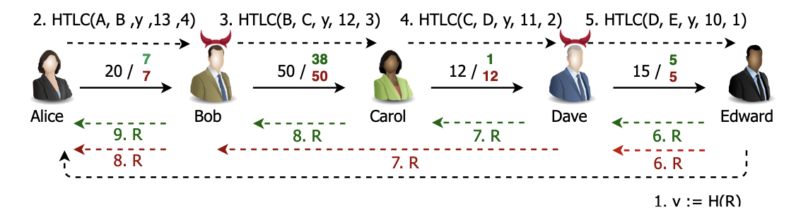
Excursion: Wormhole attacks
"In a nutshell, the wormhole attack allows two colliding users on a payment path to exclude intermediate users from participating in the successful completion of a payment, thereby stealing the payment fees which were intended for honest path nodes."
Source: https://eprint.iacr.org/2018/472.pdf

Slide 11
MuSig
Signature Aggregation

Slide 12

Naïve Signature Aggregation
𝑗 signers with (𝑥_{i}, 𝑌_{i}) want to sign message 𝑚
All signers generate 𝑅_{i} and calculate 𝑅_{comb}, c = H(𝑅_{x} ∥ 𝑚) and 𝑠_{i} = (𝑘_{i} + 𝑥_{i} 𝑒)
Partial signatures are then combined into single signature (𝑅, 𝑠_{comb})
Adding 𝑌_{i}, 𝑅_{i} and 𝑠_{i} to combined structure:
𝑌_{comb} = 𝑌₁ + 𝑌₂
𝑅_{comb} = 𝑅₁ + 𝑅₂
𝑠_{comb} = 𝑠₁ + 𝑠₂ = (𝑘₁ + 𝑥₁ 𝑒) + (𝑘₂ + 𝑥₂ 𝑒)
𝑠_{comb} ⋅ 𝐺 = (𝑘₁ + 𝑘₂) ⋅ 𝐺 + (𝑥₁ 𝑒 + 𝑥₂ 𝑒) ⋅ 𝐺
𝑠_{comb} ⋅ 𝐺 = 𝑅_{comb} ⋅ 𝐺 + 𝑌_{comb} ⋅ 𝐺
Rogue attack

Slide 13
Signature Aggregation – Rogue attack
“Corrupted signer sets its public key to 𝑌₁ = 𝑥₁ ⋅ 𝐺 (𝑌₂ + 𝑌₃ + ... + 𝑌_{j})⁻¹, allowing him to produce signatures for public keys {𝑥₁, ... , 𝑥_{j}} by himself ”
Example:
Bob knows Alice’s public key 𝑌_{A} and nonce 𝑅_{A} ahead of time
Bob lies and says that his public key is 𝑌_{B}′= 𝑌_{B} − 𝑌_{A} and public nonce is 𝑅_{B}′ = 𝑅_{B} − 𝑅_{A}
Note: Bob doesn’t know the private keys for these faked values 𝑅_{B}′ and 𝑌_{B}′
Everyone assumes that 𝑠_{comb} ⋅ 𝐺 = 𝑅_{A} + 𝑅_{B}′ + 𝑒 (𝑌_{A} + 𝑌_{B}′) as per the aggregation scheme
Alice thinks she is safe to sign a message 𝑚 and does so
But Bob is able to provide the correct signature already:
𝑠_{comb} ⋅ 𝐺 = 𝑅_{A} + 𝑅_{B}′ + 𝑒 (𝑌_{A} + 𝑌_{B}′) = 𝑅_{B} + 𝑒 𝑌_{B} = 𝑠_{B} ⋅ 𝐺
Bob could be defeated by asking him to sign a message proving that he does know the private keys 𝑅_{B}′ and 𝑌_{B}′

Slide 14
MuSig – How it works
“MuSig is a protocol for aggregating public keys and signatures for the Schnorr digital signature algorithm”
𝑗 signers with (𝑥_{i}, 𝑌_{i}) want to sign message 𝑚. All signers
generate 𝑅_{i}
share a commitment to this
share 𝑌_{i}
calculate 𝑌_{comb} by
𝑙 := H(𝑌₁ + 𝑌₂ + ... + 𝑌_{j}) where 𝑌_{i} should be ordered by convention
𝑎_{i} := H(𝑙, 𝑌_{i})
𝑌_{comb} = ∑ 𝑎_{i} 𝑌_{i}
calculate 𝑅_{comb} and 𝑐 = H(𝑅_{comb} ∥ 𝑌_{comb} ∥ 𝑚) and 𝑠_{i} = (𝑘_{i} + 𝑥_{i} 𝑎_{i} 𝑐)
share 𝑠_{i}
combine results into single signature (𝑅_{comb} , 𝑠_{comb})

Slide 15
MuSig2
Same as MuSig but eliminates (2.) sharing the commitment 𝑅_{i} to and allows (1.) first round to be combined with (3.) key exchange. How?
Difference in calculation of 𝑅_{i}:
“Each signer i sends a list of 𝑣 ≥ 2 nonces 𝑅_{i,1}, ... , 𝑅_{i,𝑣} (instead of a single nonce 𝑅_{i}), and effectively uses a linear combination 𝑅_{i}* = ( 𝑅_{i,1} + 𝑅_{i,1} + ... + 𝑅_{i,1}) + ... + ( 𝑅_{i,𝑣} + 𝑅_{i,𝑣} + ... + 𝑅_{i,𝑣}) of these 𝑣 nonces, where the number of additions of 𝑅_{i,k} is derived via a hash function.”
https://eprint.iacr.org/2020/1261.pdf

Slide 16
MuSig2 – Attacks
Rogue attack prevention proof:
https://tlu.tarilabs.com/cryptography/introduction-schnorr-signatures#key-cancellation-attack
“Bob must somehow know Alice’s private key and the faked private key...”
All good!
No! Replay Attacks!
After one ceremony, Bob has everything at hand to perform a rogue attack again...
???

Slide 17
MuSig – Versions
MuSig
simple to implement
but requires 3 rounds of communication during signing process
MuSig2 → is going to be implemented
simple to implement
eliminates 1 round of communication and allows another round to be combined with key exchange
can allow using a similar signing process to that used with script-based multisig.
requires storing extra data and being careful about ensuring signing software or hardware can’t be tricked into unknowingly repeating part of the signing session
MuSig-DN (Deterministic Nonce)
significantly more complex to implement
communication between participants can’t be combined with key exchange
but has the advantage that it’s not vulnerable to the repeated session attack

Slide 18
Taproot
Tweaked public key

Slide 19
Taproot – Tweaked public key
Old
New
 | Current TX | Commitment TX
 | Input (e.g. lightning channel funding TX)
 | Sig A: (𝑅, 𝑠)_{A} ✓ Sig B: (𝑅, 𝑠)_{B} ⬜ |  |  | 1 BTC
 | Output
 | P2PKH w/ locktime 𝑌_{B} 📅 locktime | P2SH 𝑌_{A} 𝑌_{B} |  | 1 BTC
 | Taproot TX | Commitment TX
 | Input (e.g. lightning channel funding TX)
 | Sig A: (𝑅, 𝑠)_{A} ✓ Sig B: (𝑅, 𝑠)_{B} ⬜ |  |  | 1 BTC
 | Output
 | P2TR (Pay to taproot) 𝑌*_{comb} |  |  | 1 BTC
2-of-2 aggregate key: 𝑌_{comb} = 𝑌_{A} + 𝑌_{B}
E.g. timelock script: 𝑆 = "<timeout> OP_CSV OP_DROP 𝑌_{B} OP_CHECKSIGVERIFY”
New key which is published: 𝑌*_{comb} = 𝑌_{comb} + H(𝑌_{comb} || 𝑆) ⋅ 𝐺

Slide 20
Taproot – Tweaked public key
Two spending rules: Spending like it was
P2SH 𝑌*_{comb} = 𝑌_{A} + 𝑌_{B} + H(𝑌_{comb} || 𝑆) ⋅ 𝐺
One party adds H(𝑌_{comb} || 𝑆) to private key, e.g. 𝑌*_{A} = (𝑥₂ + H(𝑌_{comb} || 𝑆)) ⋅ 𝐺
A and B provide signatures (𝑠*_{comb}, 𝑅_{comb}) in new TX to unlock the funds (MuSig2)
P2PKH to 𝑌_{B} with locktime
B provides 𝑆, 𝑌_{comb}, 𝑌_{B} and 𝑠_{B}
H(𝑌_{comb} || 𝑆) can be calculated by miner
Miner checks that 𝑌*_{comb} = 𝑌_{comb} + H(𝑌_{comb} || 𝑆) ⋅ 𝐺 is fulfilled
Miner runs script 𝑆
Public key of B 𝑌_{B} is checked within script "<timeout> OP_CSV OP_DROP 𝑌_{B} OP_CHECKSIGVERIFY”

Slide 21
Sources
ECDSA:
https://www.youtube.com/watch?v=n5aompcR9W0 (Rene Pickhardt)
Schnorr:
https://medium.com/cryptoadvance/bls-signatures-better-than-schnorr-5a7fe30ea716
https://medium.com/cryptoadvance/ecdsa-is-not-that-bad-two-party-signing-without-schnorr-or-bls-1941806ec36f
https://medium.com/cryptoadvance/how-schnorr-signatures-may-improve-bitcoin-91655bcb4744
MuSig:
https://eprint.iacr.org/2018/068.pdf (Inital paper)
https://eprint.iacr.org/2020/1261.pdf (MuSig2 paper)
https://www.youtube.com/watch?v=n5aompcR9W0 (Rene Pickhardt)
https://bitcoinops.org/en/topics/musig/
https://lists.linuxfoundation.org/pipermail/lightning-dev/2021-November/003336.html (LN Summit 2021 Notes & Summary/Commentary)
https://tlu.tarilabs.com/cryptography/introduction-schnorr-signatures#key-cancellation-attack (Rouge / key cancellation attack)

Slide 22
TBD
How does Taproot TX vs. SegWit vs. legacy look like?
Channel factories
MAST - Merklized Abstract Syntax Trees
Point-Time-Locked-Contracts (PTLCs) (https://bitcoinops.org/en/topics/ptlc/)
conditional payments that can replace the use of HTLCs in LN payment channels, same-chain coinswaps, some cross-chain atomic swaps, and other contract protocols
compared to HTLCs, they can be more private and use less block space
Eltoo (https://bitcoinops.org/en/topics/eltoo/)
proposed enforcement layer for LN that allows any later channel state to replace any earlier channel state
can be used with a penalty mechanism like the one used with existing LN channels, but eltoo doesn’t need the penalty mechanism in order to be secure

Slide 23
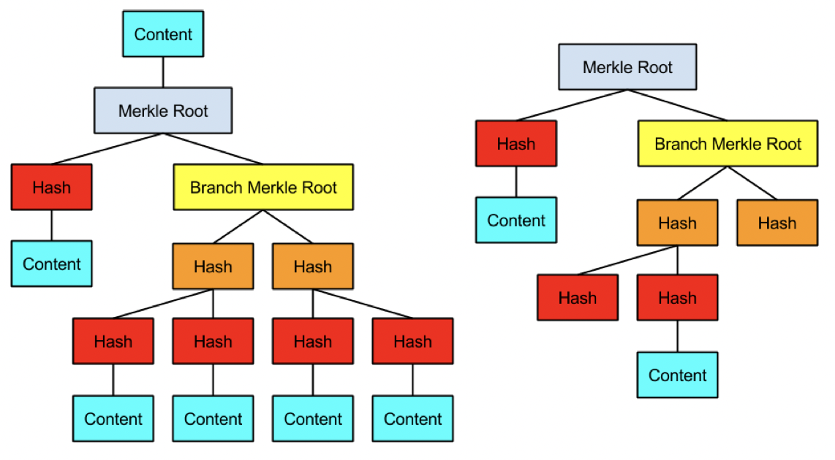
Taproot: MAST (Merklized Abstract Syntax Trees)
Taproot resembles MAST and always includes a condition where all participants can cooperate to spend the funds: the “cooperative close.”

Slide 24
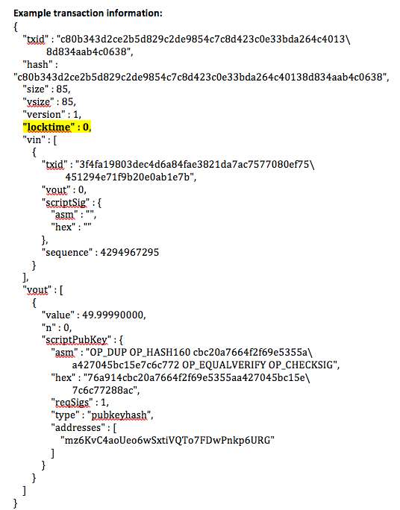
MAST (Merklized Abstract Syntax Trees)
Example: Combined locktime contract
Bob can spend the 10 BTC only if he waits 7 days
If he wants to spend them before 7 days elapse, he can only access 4 BTC and the remaining 6 should be returned to Alice at a specified address.
Bob can access the 10 BTC before 7 days but only if Charlie also signs the transaction.

Slide 25
MAST
MAST (Merkelized Abstract Syntax Tree) is a proposed solution that uses Merkle trees (a decades-old, compact data structure invented by cryptographer Ralph Merkle) to work around these two downsides. In short, all the different conditions under which the funds can be spent are individually hashed (as opposed to combined into a single hash) and included in a Merkle tree, which ultimately produces a single hash: the Merkle root. This Merkle root “locks up” the coins.
Yet with Schnorr, Taproot can do even better: a transaction can hide that a MAST-structure existed at all.

Slide 26
Sources
https://bitcoin.stackexchange.com/questions/96025/what-are-some-interesting-applications-of-taproot-smart-contracts
https://bitcoinmagazine.com/technical/taproot-coming-what-it-and-how-it-will-benefit-bitcoin
https://tara-annison.medium.com/what-are-taproot-mast-and-schnorr-signatures-b737dae20681
https://rubin.io/public/pdfs/858report.pdf
https://lists.linuxfoundation.org/pipermail/bitcoin-dev/2018-January/015614.html

